Slide 1

Resilience and Chaos Engineering
Notes:
What is resilience and chaos engineering?
Hopefully you all have an idea of what resilience engineering is
Chaos engineering – Not adding chaos , but planning for when – not if – chaos occurs
I'd talked previously about the theory behind Chaos Engineering. What I'd like to talk about today is more around practical examples of chaos, and how chaos and resilience engineering could of helped.
A lot of developers don't really spend a lot of time thinking about how we can build our applications to factor in resilience engineering, but we can't be in a position where we expect that this is the responsibility of Operations. We are moving into a DevOps world, and that means that resilience, and chaos engineering, become as much as responsibility of you as developers, as it does the boys and girls in operations.

Slide 2
Reliability
Services break or go offline
The more complex the service, the more likely this is going to happen
The more interlinked a series of services is, the more likely this is going to happen
And so?
When you are building your plan for your big money-making app; take a step back and plan for failure!
Notes:
In my experiences we always have a dream of a solution or service we have built and deployed will never break or go offline. The reality is, the dream will never come true! This is not always down to bad engineering, bad vendors or bad infrastructure! Think of the all that is involved in a service from the World Wide Web and physical network connections to an SSL certificate.

Slide 3
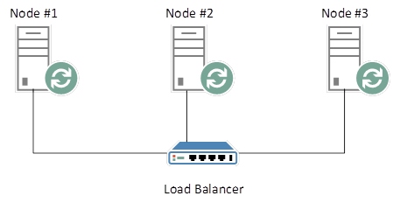
The basics – multi-node clusters
Notes:
Old skool, but still relevant even when we’re talking about cloud-based solutions.
Explain how traffic gets distributed, and nodes can fail over.
Blue / green deployments and canary releases

Slide 4
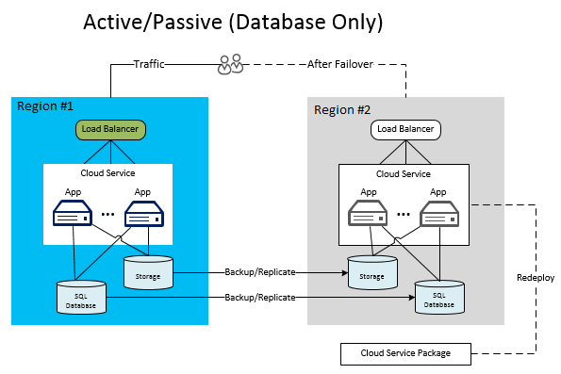
Disaster Recovery
RPO and RTO
Notes:
Recovery Point Objective (RPO) describes the interval of time that might pass during a disruption before the quantity of data lost during that period exceeds the Business Continuity Plan’s maximum allowable threshold or “tolerance.”
The Recovery Time Objective (RTO) is the duration of time and a service level within which a business process must be restored after a disaster in order to avoid unacceptable consequences associated with a break in continuity. In other words, the RTO is the answer to the question: “How much time did it take to recover after notification of business process disruption?“
RPO designates the variable amount of data that will be lost or will have to be re-entered during network downtime. RTO designates the amount of “real time” that can pass before the disruption begins to seriously and unacceptably impede the flow of normal business operations.
When did it become acceptable for companies to stop thinking about Disaster Recovery? Once again in the Public Cloud people assume, they can survive a disaster because its someone else problem. People like AWS provide a platform for you to build highly available and resilient services, they do not do it for you!

Slide 5
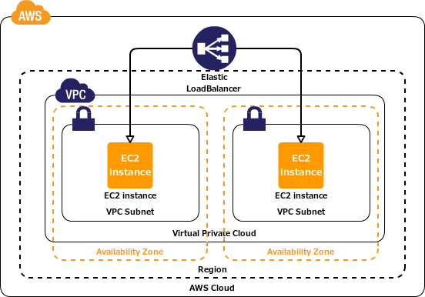
Public cloud
Multiple Availability Zones
Multi region?
Multi cloud?!?
Notes:
Public Cloud. Well it promises to reduce your running costs and make your service secure, compliant and resilient. Well that’s the biggest lie and we should all know that by now! How many customers were effected by S3 outage last year? Now that’s a simple service that provides an object-based file store. How many customers do you think now runs S3 with a copy of that data elsewhere ready to be pointed at WHEN S3 fails again?
We can’t always catch stuff before it smashes but we can definitely learn from it!
Do we honestly think multi-AZ is resilient, we all know we could go multi-region or multi-cloud? Reliability comes with cost. It’s an insurance, which again we all pay for insurances we hope to never use so why would we shy away from that with a production service?

Slide 6
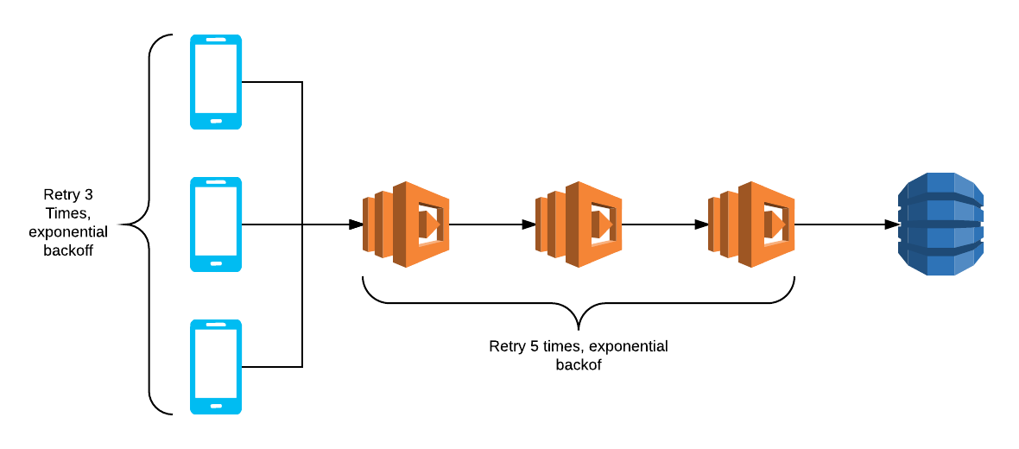
An example – the retry storm
Clients are configured to retry a set number of times
A traffic spike occurs, and requests are queued
Number of queued requests builds and builds
Notes:
A "retry storm" is caused when clients are configured to retry a set number of times before giving up, a retry policy is necessary because of packets loss will occur in normal operation of a service.
If for example the services as a whole were scaled to support 80,000 requests per seconds and run at about 80% of capacity, a spike in traffic that caused the service to receive 101,000 requests per second would cause 1,000 of those requests to fail.
When the retry policies kick in, you end up with additional 1,000+ requests, depending on where the failure was detected which would push the service as a whole up to 102,000 requests per second - from there your service goes into a death spiral doubling the number of failed requests every second.
How critical is this – is absolute then we can only over-provision. If it’s only a mild annoyance however then we accept that some users will be inconvenienced
In the client code write sensible retry logic which has an upper limit and a mechanism for gracefully failing. That way you don't stick your users in an infinite loop of failing requests and you just give them an error telling them to try whatever they just did in little while.
For your server side infrastructure the simplest solution is to throttle. Hard limits on requests, especially if you can try and spread them logically based on your specific use case (ie. If you have a centralised service make some hard decisions, do you want to start blocking geographically distant requests which might be resulting in threads hanging server side? Or do you want to distribute your inevitable yet minor outage evenly? etc) It basically boils down to the fact that returning a 503 intentionally from a gateway is a hell of a lot cheaper than letting the request go through and sending a 504 anyway. Basically force clients to behave based on what you can currently provide and provide the correct responses so that clients can react appropriately.

Slide 7
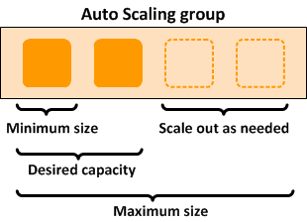
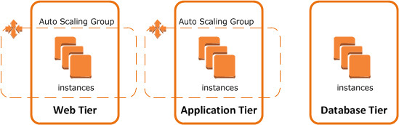
Autoscaling
Notes:
Aggressive Scale up, cautious scale down

Slide 8

An example
Akamai CDN
Journey-based monitoring
Multi-cloud as well as on-prem DC
Notes:
The biggest airline is the UK is one of the best at ensuring the site is highly available for traffic spikes, development issues and unexpected incidents. They use tools such as Akami for CDN so the origin resources are not under load and pressure that normally cracks first. They have journey based monitoring (automated booking process) so they can graphically see if a journey (booking process) experienced anything other than the expected. With this they expanded it to monitor booking a random flight, to booking a specified flight with a seat reservation, hotel and car hire. Every piece of Infrastructure is being monitored with a failure playbook ready on each alert that is received. They host services in different clouds and also on-prem hosted data-centres. They run multiple test streams of the web-site that are destroyed post release and a new one built reducing the wastage of developing and testing on an out-of-date image that WILL cause failure. The company focus has 2 real main focusses, 1) Flying customers safely around Europe. 2) Ensuring they have always have an online presence for customers to book and manage bookings.
The most impressive thing about this is not the fact they are able to see every little blip but when they do see it they are able to investigate it and provide a fix!

Slide 9
Simian Army
Notes:
Chaos Monkey is a service which identifies groups of systems and randomly terminates one of the systems in a group.
Chaos Gorilla, drops a full Amazon Availability Zone.
Janitor Monkey is a service which runs in the Amazon Web Services (AWS) cloud looking for unused resources to clean up.
Conformity Monkey is a service which runs in the Amazon Web Services (AWS) cloud looking for instances that are not conforming to predefined rules for the best practices.
Latency monkey Introduces communication delays to simulate degradation or outages in a network.
Doctor monkey Performs health checks, monitoring performance metrics like CPU load to detect unhealthy instances for root-cause analysis and eventual fixing or retirement.
Security monkey Derived from Conformity Monkey, a tool that searches for and disables instances that have known vulnerabilities or improper configurations.

Slide 10
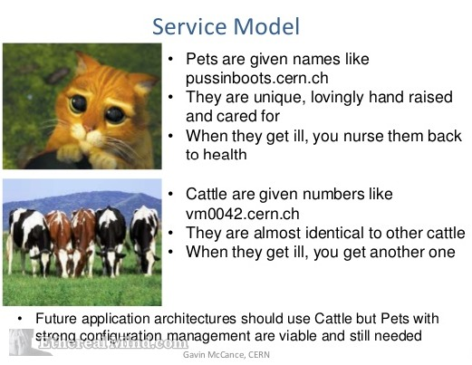
Code for cattle, not pets
Pets:
Servers that are treated as indispensable or unique systems that can never be down.
Typically they are manually built, managed, and “hand fed”.
Cattle:
Arrays of more than two servers, that are built using automated tools, and are designed for failure, where no one, two, or even three servers are irreplaceable.
Typically, during failure events no human intervention is required as the array exhibits attributes of “routing around failures” by restarting failed servers or replicating data through strategies like triple replication or erasure coding.
Notes:
Pets
Servers or server pairs that are treated as indispensable or unique systems that can never be down. Typically they are manually built, managed, and “hand fed”. Examples include mainframes, solitary servers, HA loadbalancers/firewalls (active/active or active/passive), database systems designed as master/slave (active/passive), and so on.
Cattle
Arrays of more than two servers, that are built using automated tools, and are designed for failure, where no one, two, or even three servers are irreplaceable. Typically, during failure events no human intervention is required as the array exhibits attributes of “routing around failures” by restarting failed servers or replicating data through strategies like triple replication or erasure coding. Examples include web server arrays, multi-master datastores such as Cassandra clusters, multiple racks of gear put together in clusters, and just about anything that is load-balanced and multi-master.

Slide 11
A summary
What capabilities are present in a system?
Think about capacity
How do we build infrastructure to support adaptive capacity?
How should our code reflect that, and our ways of working (Conway’s Law)
There is no problem so bad that you cannot make it worse
Notes:
RE forces us to look at what capabilities are present within a system before a chaotic event occurs.It asks us to think about our capacity to adapt in the face of high tempo, high consequence, and uncertain situations, and to look at ways to fill out or increase that capacity.It challenges us to figure out how we can build infrastructure to support this adaptive capacity in a long term, sustainable way, in all parts of our system.Lastly, it poses these questions not only of the code we write and the cloud we run it upon, but it asks us to weigh in on what it means for the people that run our systems, the teams those people come together to form, and the whole organization that is comprised of those teams.

